Slide 1
Internet Addiction in Children and Teens
Christopher Mulligan LCSW
The Cyber Addiction Recovery Center
11140 Washington Blvd.
Culver City, CA 90232
www.teenvideogameaddiction.com

Slide 2
Framework for Presentation
1) There is a subgroup of children and teens for whom the Internet and gaming should be viewed as a public health problem – a public health problem that we as a society are struggling to recognize and address.
2)The internet and gaming can be viewed in terms of a massive, unfiltered, source of stimulation that affects multiple domains of development: social, emotional, attachment, cognitive, communication, and sensory motor.
3) Any discussion of online safety should include a discussion of the impact of the internet – and technology more generally – is having on child and adolescent development and mental health.

Slide 3
Teen use of the “net”
Over the past five years the Internet has come to occupy a central place in the lives of children and teens.
Teens use the Internet for communication with friends and family, school-related research, artistic expression, recreation, purchasing music/videos, and participation in local and global political movements.
Most teens view the Internet as a way of enhancing their off-line lives and are able to find a balance between the time they spend in three dimensional reality and virtual reality.

Slide 4
Kaiser Family Foundation Study: 11 hours per day
The average amount of time teens are now “connected” to tech is 11 hours per day. What?
Although there is no specific amount of time on the internet that has been confirmed to result in addiction or mental health problems in teens , it is clear that teens who lose the ability to balance their interest in online activities and off-line activities, experience significant social, emotional, and academic problems.
Constant engagement with online activities can reduce motivation to develop and expand crucial offline social-emotional capacities such as self-awareness, empathy, resilience, initiative, deliberation, and collaboration.

Slide 5
The 10 percent
Unfortunately, there is a sizable minority of teens -- current research suggests as many as 10% -- that cannot regulate their use of the Internet and lose their ability to balance their off-line and online lives.
There is an ongoing debate within the medical and mental health communities about whether the term “addiction” should be applied to teens and adults who have lost the capacity to regulate their use of the internet and gaming .
Medical and mental health professionals are also debating whether sustained use of the internet results in and/or exacerbates depression, anxiety, personality disorders, and psychotic states.

Slide 6
Challenges with Internet Addiction Research
There is disagreement among specialists regarding definition of “addiction”
Measures have been based on physical addiction models
Measures have not been extensively validated
Most studies are based on self report surveys and are only correlational
Many studies are too small or selective (e.g., based on students)
Internet and technology behavior is very complex, and not a single construct
There is little consistency in findings regarding approach or treatment

Slide 7
Teens and Net Addiction?
Although this debate is far from being resolved -- and therefore additional research is needed -- it is clear to clinicians that specialize in problematic technology use that there is a subset of teens who exhibit behaviors seen in process or behavioral addictions such as gambling, shopping, and sexual activity.

Slide 8
Process Addiction
“Process Addiction” – disorder of behavior, not abuse of a substance
“Pathological Internet Use” (PIU)
Term coined by Kimberly Young, Ph.D.

Slide 9
Types of Potential Overuse
Checking e-mail
Facebook, Twitter, etc
Texting
Multitasking
Switchtasking
News browsing
Web surfing
Online gaming

Slide 10
Types of Potential Overuse
Online shopping/bidding
Chatrooms
Online gambling
Online pornography
Cybersex
Cyber bullying

Slide 11
The Hook: The Dopamine Rush
Internet use, especially social applications such as e-mail, texting, instant messaging, and social media sites, result in the activation of “pleasure centers” in the brain which, in turn, results in an increase in the level of the neurotransmitter dopamine.
Dopamine is a neurotransmitter that is increased by both substance and process addictions: cocaine, compulsive shopping, gambling, and sexual activity.
High levels of dopamine produce high levels of pleasure - including euphoric states - which can result in a teenager pursuing online activities at the expense of focusing on off-line activities and responsibilities.

Slide 12
Dopamine and Desensitization and Tolerance
Dopamine levels can be affected by heredity and trauma
Frequent release of dopamine reduces the number and sensitivity of dopamine receptors– more stimulation is required to achieve the same pleasure (desensitization & tolerance)
Cravings are stimulated by cues or delay in involvement in the stimulating activity

Slide 13
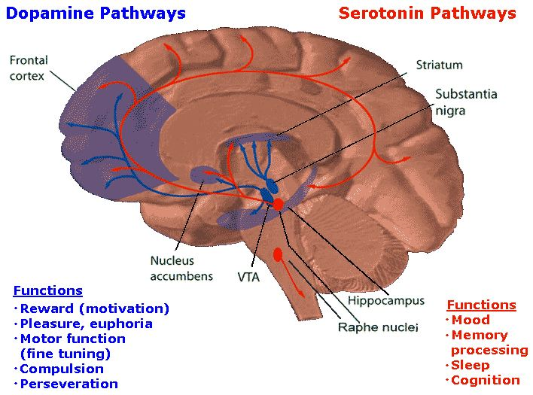
Dopamine Pathways

Slide 14
How media becomes addictive: reinforcement schedule
Variable (intermittent) ratio reinforcement schedule.
Create a state of anticipation/expectation.
Facebook requests, photo tags, friend updates, direct messages, and chat all create anticipation.
Dopamine keeps users craving more; it drives stimulation seeking.
Some people have as much as a 9% increase in dopamine when they listen to their favorite music (cocaine is 22%) (Salimpoor et al., 2009).

Slide 15
Signs of Internet Addiction
Cravings/preoccupation: teens develop an almost constant craving/psychological preoccupation with being online via the computer and/or smart phone.
Tolerance: teens develop the need to spend increasing amounts of time online in order to feel excitement and satisfaction (e.g., one hour per day becomes three hours and three hours becomes five hours).
Withdrawal symptoms: teens experience anxiety, anger/rage, irritability, and/or depression when they are off line.
Persistence of behavior despite negative consequences: teens continue to engage in ever-increasing amounts of time online despite obvious negative consequences, e.g., conflict with parents, loss of off-line friendships, neglect of school work, failing grades, neglect of chores, reduction in physical activity, fatigue, and overall poor health.

Slide 16
Signs of Internet Addiction
Social communications and interests are lost: loss of interest in hobbies, social interaction, and recreation.
Alleviation of negative emotions: use of the internet to escape or alleviate dysphoric mood (e.g., feelings of helplessness, hopelessness, guilt, anxiety).
Hiding use from friends and relatives: deception of actual costs/time of internet involvement to family, friends, therapists, and others.

Slide 17
The Internet’s Impact on Mental Health
In addition to addiction, researchers and clinicians world wide are seeing a cluster of serious mental health problems that appear to be caused by or exacerbated by the overuse of the internet.
What is known about the impact of the Internet on adolescent mental health?
The following represents a summary of current thinking on the impact of the internet on adolescent mental health.

Slide 18
At risk groups: depression and compulsive net use
Although the internet increases dopamine, teens who spend significant amounts of time online (25-30 hours per week) frequently present with symptoms of depression.
Multiple studies have shown that teens and adults who devote a significant majority of their social and recreational time to online activities and relationships, present with symptoms of depression.
It is not clear at this time whether being online 25 or more hours per week produces depression or whether teens who have depression seek out Internet related social and recreational activities.
In either case, the Internet does not improve the mood of teenagers and may in fact produce a mood disorder or exacerbate a pre-existing mood disorder.

Slide 19
At risk groups: the net and ADHD
Teens that have been diagnosed with ADHD are drawn to the Internet, particularly online gaming.
It has long been documented that teens with ADHD are at high risk for drug and alcohol addiction due to deficits in the functioning of the prefrontal cortex.
Research has confirmed that teens with ADHD are drawn to the dopamine producing activities offered by the Internet, resulting in high rates of compulsive/addictive use of technology.
Internet use for the ADHD teen appears increase their core deficits by providing a way to experience constant novelty and dopamine induced euphoric states.

Slide 20
The net and Autism: a worst case scenario
Teens with Autism are also vulnerable to the compulsive use of the Internet, including online gaming, social media sites, YouTube videos, and research on areas of special interest.
The problem for the teen with Autism is the pleasure that is experienced through the Internet serves as an obstacle for remediating the core social and cognitive deficits associated with Autism.
The Internet represents a worst case scenario for teens on the autism spectrum in that it produces high levels of pleasure spent in complete social isolation, resulting in withdrawal from the types of off-line activities needed to improve their overall social and emotional functioning.

Slide 21
The “cure” for social anxiety
In addition to producing pleasure/euphoric states, Internet use allows socially anxious teens to engage in social relationships with a wide variety of online “friends.” It is well documented that the Internet can help a socially anxious and isolated teen feel confident and popular.
The problem for these teens is that the commitment to online relationships ultimately overtakes their motivation to improve off-line relationships, resulting in a withdrawal from three-dimensional reality.
This withdrawal can have devastating consequences if teens stop pursuing age appropriate social and emotional challenges, opting instead to remain within the safety of their preferred virtual reality.

Slide 22
Impulsive behaviors: the “disinhibition effect.”
In addition to causing and/or exacerbating depression, ADHD ASD and social anxiety, the net also increases impulsive behaviors.
Research on cyber behavior has identified a universal phenomenon referred to as the “disinhibition effect.”
In this context disinhibition refers to impulsive online behaviors -- such as sending multiple inappropriate e-mails or texts (raging/stalking), engaging in sexual risk-taking behaviors (sexting or online porn), binge shopping, gambling, and bullying.
It is currently believed that the combination of anonymity and invisibility results in impulsive and destructive behaviors online - behaviors that a person would inhibit off-line.

Slide 23
Online pornography: the arousal template
Increasing numbers of teens are developing significant problems with online pornography.
The combination of the accessibility and intensity of online sexual stimulation is resulting in increasing numbers of teens becoming preoccupied with cybersex -- to the exclusion of pursuing sexual and romantic relationships off-line.
Teens are becoming involved in perverse and deviant areas of sexual behavior including fetishes and child pornography.
Ongoing exposure to cyber pornography actually serves to rewire the adolescent brain in such a way that their sexual preferences -- or what is referred to as their “arousal template” -- is oriented only towards “porn sex” and not towards healthy sexual behavior and emotional intimacy.

Slide 24
Summary:
The majority of teens manage the Internet successfully and are fully capable of taking advantage of the many opportunities that are unique to the Internet: creating art, editing music, editing video/photos, writing code, engaging in local and global political action, creating blogs, creating websites, and maintaining healthy off-line relationships.
Unfortunately, the Internet is a toxic form of stimulation for as many as ten percent of teens, resulting in addiction, isolation, impulsivity, depression, anxiety, self-absorption, compulsive shopping and gambling, compulsive sexual behavior, and an inability to engage in meaningful self-reflection and empathy.

Slide 25
Screening for at risk teens.
Pediatricians, teachers, and mental health professionals are in a position to identify children and teens that are experiencing the negative mental health consequences of technology overuse.
Adults that work with children and teens need to learn to conceptualize mental health problems as being either created by or exacerbated by technology overuse and then learn which teens are most at risk for technology overuse.
How would a pediatrician, teacher or mental health professional know who to focus on? More than likely, the child/teen that is struggling online is the same child/teen who is struggling off-line – generally with a psychiatric and/or developmental challenge.
The Internet provides a powerful solution to complex off-line problems, a solution that unfortunately increases off-line vulnerabilities and challenges.

